Slide 1

Control Unit Design Module 4
Nilanjan Byabarta

Slide 2
Sample questions on last slide

Slide 3
Introduction to Control Unit
Hardwired Control Unit
Microprogrammed Control Unit
Horizontal Microprogramming
Vertical Microprogramming

Slide 4
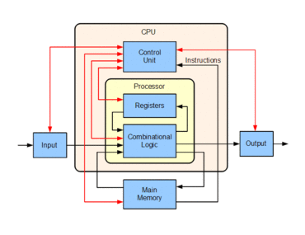
Building blocks of a central processing unit
Registers
Program Counter (PC), Instruction Register (IR), Memory Address Register (MAR), Memory Data Register (MDR), Accumulator (AC) etc.
Arithmetic Logic Unit (ALU)
Control Unit
Timer or clock circuit

Slide 5
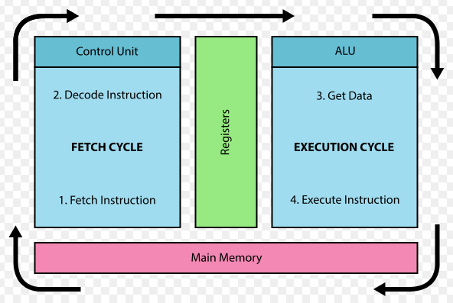
CPU sequentially executes the instructions of a program phase by phase – Fetch, Decode, Operand Fetch, Execution, Write Back.
Each instruction is executed by performing a sequence of micro-operations synchronized with timing signal.

Slide 6
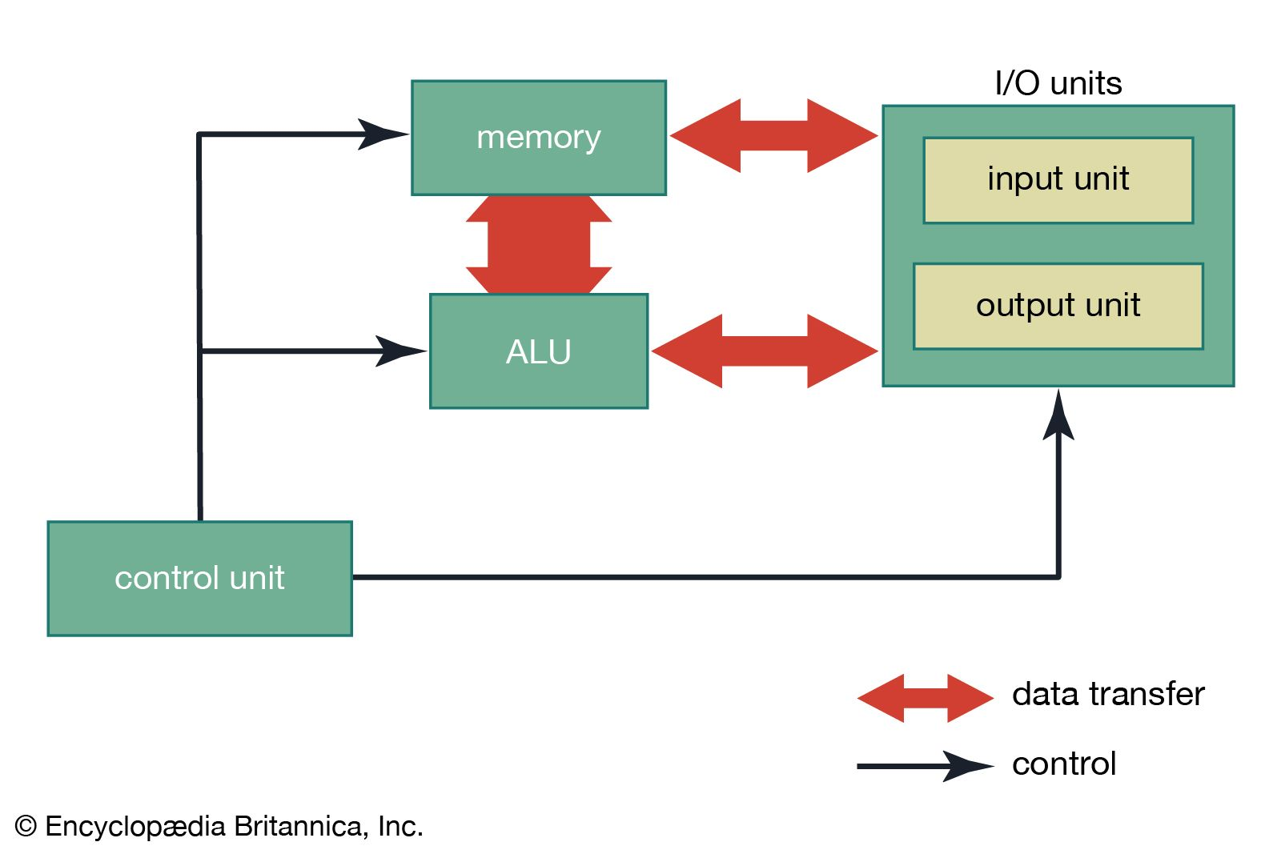
Control Unit controls system operations
Control Unit issues a sequence of control signals to initiate sequences of micro-operations, synchronized with the master clock.
The control signals enables the associated processing hardware units and handles exceptions.
Primary responsibilities:
Instruction interpretation – decodes the instructions
Instruction sequencing

Slide 7
To control the system operations by routing the selected data items to the selected processing hardware of ALU
To activate the associated processing hardware units by generating a set of signals that are synchronized with a master clock
The inputs to the control unit-master clock, status information from the processing unit and command signals from external devices like I/O, memory
The output of control unit -the signals that activate the processing units and Respond to the external environment.

Slide 8
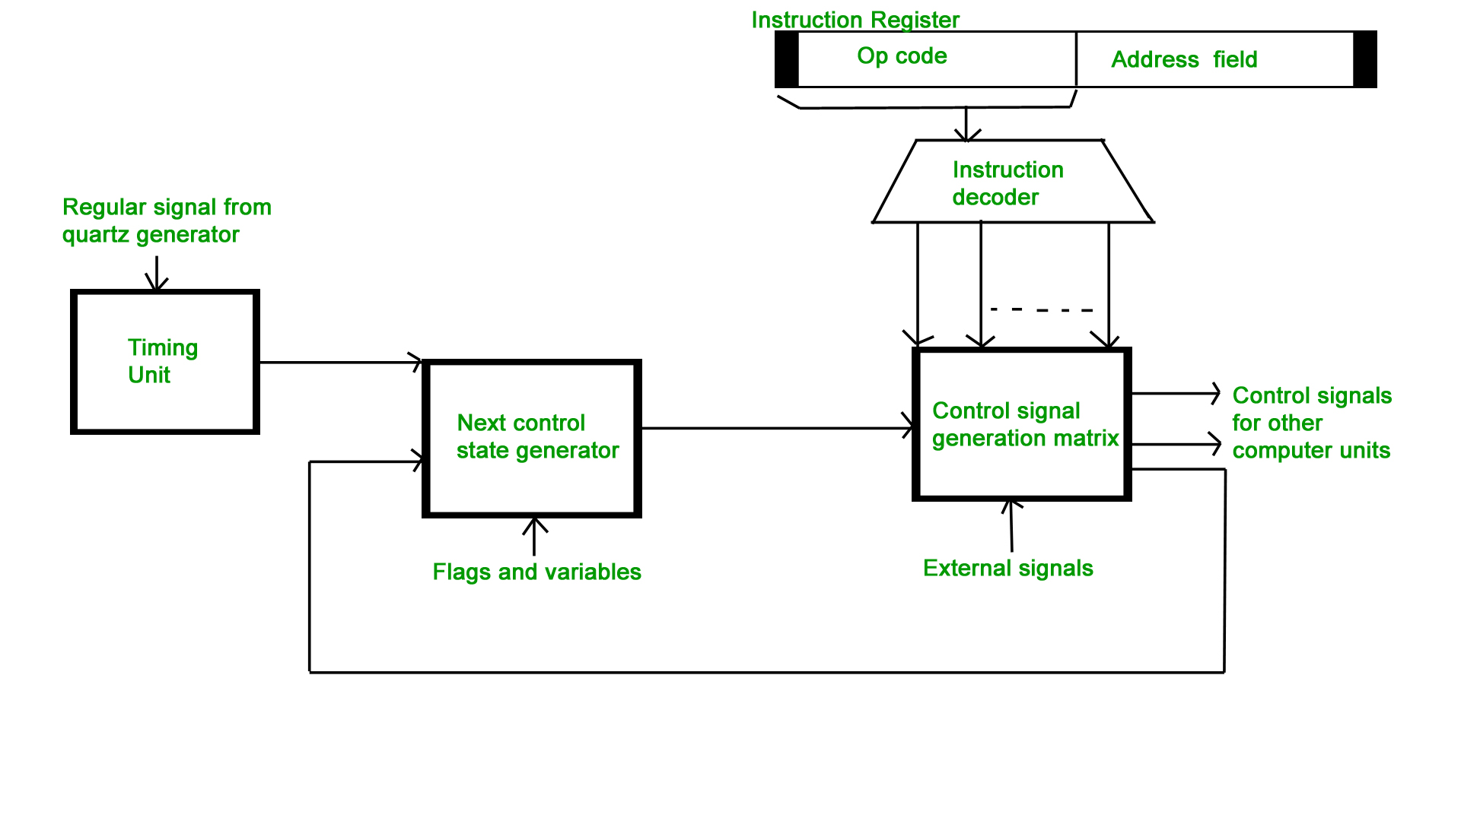
Control Unit Design Methods
Two major types of control organization –
Hardwired control
Microprogrammed control
Factors to consider
Cost effectiveness
Efficiency

Slide 9
Hardwired Control Unit
Hardwired control unit – The control signals are generated by hardwire using conventional sequential logic design techniques.
Control logic is implemented with logic gates, flip-flops, decoders etc.
Efficient – can be optimized to operate fast
Design change is costly - requires changes in the hardwire components and wiring

Slide 10
An instruction read from memory is placed in the instruction
register (IR).
The instruction register is divided into three parts: the I bit, operation code, and address part.
First 12-bits (0-11) to specify an address, next 3-bits specify the operation code (opcode) field of the instruction and last left most bit specify the addressing mode I.
I = 0 for direct address
I = 1 for indirect address

Slide 11
First 12-bits (0-11) are applied to the control logic gates.
The operation code bits (12 – 14) are decoded with a 3 x 8 decoder.
The eight outputs (D0 through D7) from a decoder goes to the control logic gates to perform specific operation.
Last bit 15 is transferred to a I flip-flop designated by symbol I.
The 4-bit sequence counter SC can count in binary from 0 through 15.
The counter output is decoded into 16 timing pulses T0 through T15.
The sequence counter can be incremented by INR input or clear by CLR
input synchronously.

Slide 12
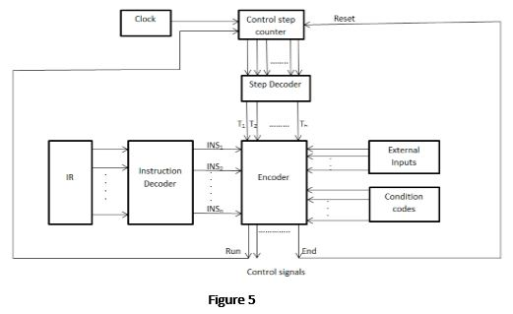

Slide 13
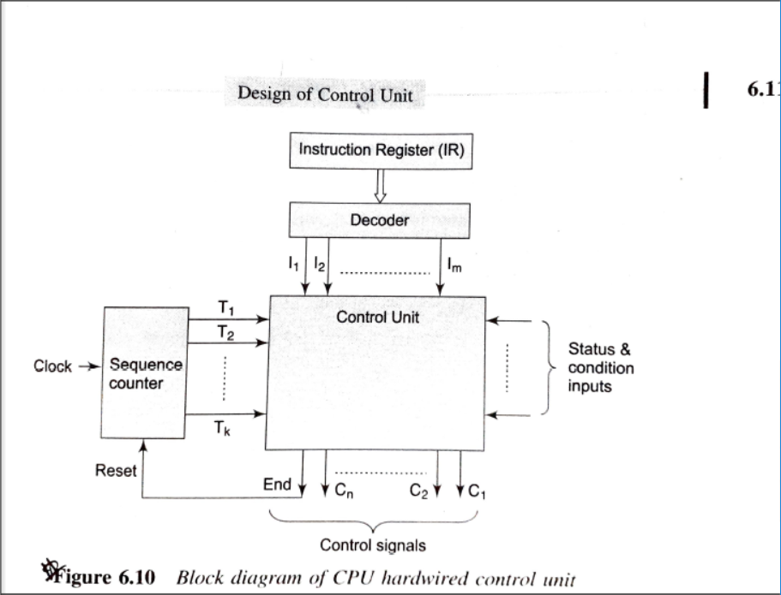

Slide 14
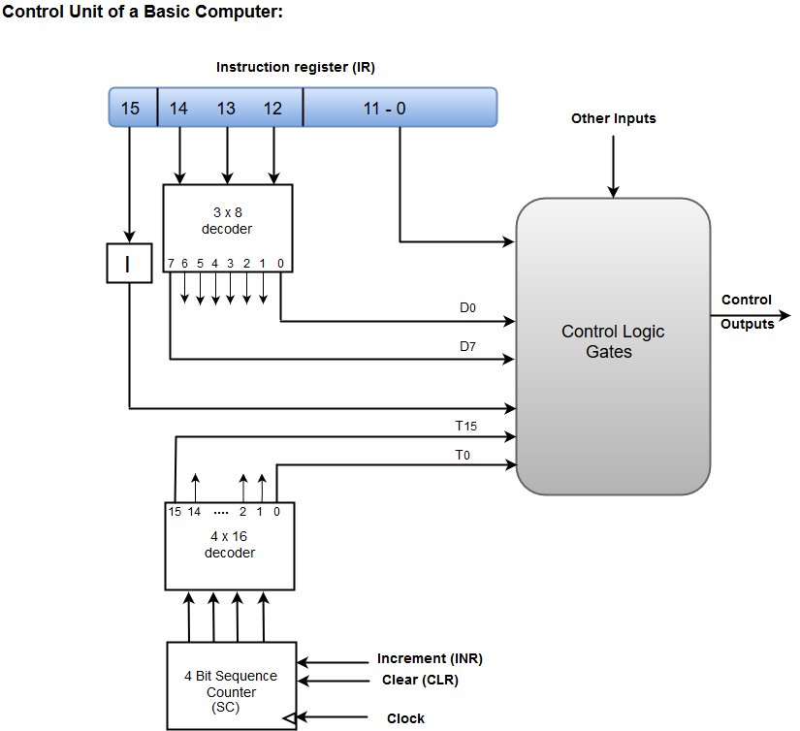
The Outputs Of The Control Logic Circuit:
1. Signals to control the inputs of the registers
2. Signals to control the read and write inputs of memory
3. Signals to set, clear, or complement the flip-flops
4. Signals select a register for the bus
5. Signals to control the AC adder and logic circuit

Slide 15
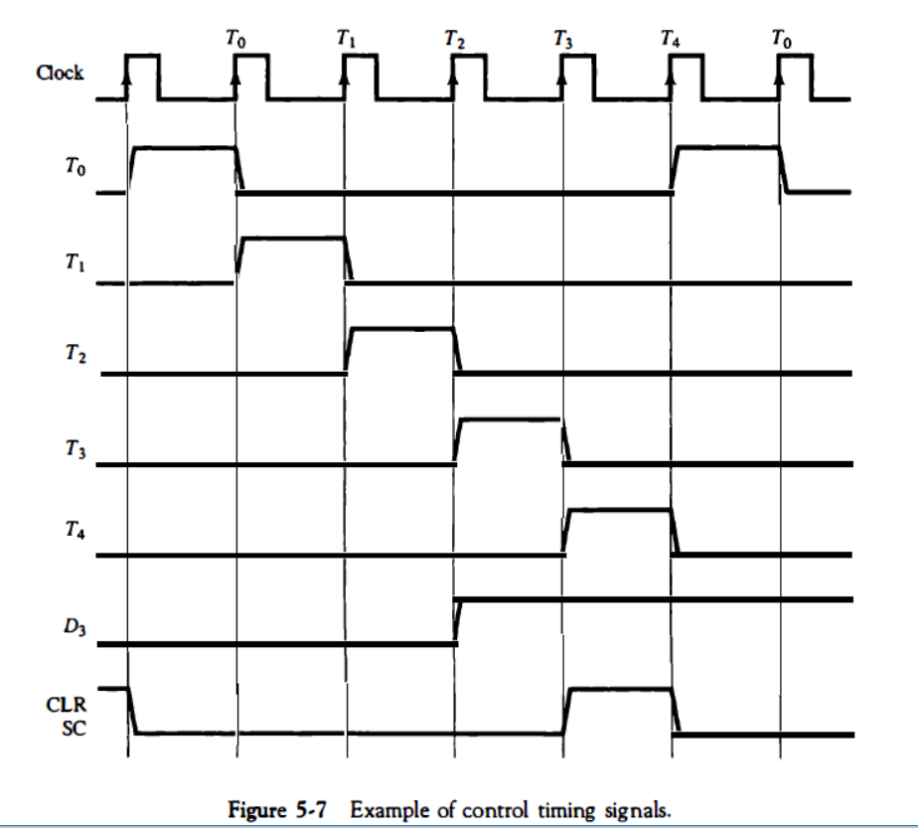

Slide 16
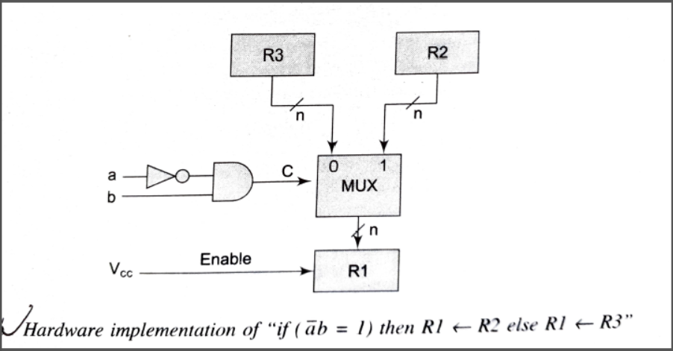

Slide 17
The control unit design is done based on the register transfer micro-operations and their analytical description.
Examples of Control Functions And Micro-operations :
Instruction Fetch & Decode phase:
T0: MAR <- PC // MAR: Memory Address register
T1: IR <-M[MAR], PC <- PC + 1 // IR: Instruction Register
T2: D0, • • • , D7 <- Decode IR(op-code),
MAR <- IR(operand_addresses)
Load to Accumulator(AC) operation (LDA opcode):
D2T4: MDR <--- M [AR] // MDR: Memory Data Register
// D2: operation decoder signal for LDA opcode
D2T5: AC <--- MDR, SC <--- 0 // SC: Sequence Counter

Slide 18
The Outputs Of The Control Logic Circuit:
1. Signals to control the inputs of the registers
2. Signals to control the read and write inputs of memory
3. Signals to set, clear, or complement the flip-flops
4. Signals select a register for the bus
5. Signals to control the AC adder and logic circuit

Slide 19
Microprogrammed Control Unit
Microprogrammed Control Unit – The control information is stored as a microprogram in the control memory.
Each instruction in the microprogram is a micro-instruction.
Efficiency – slower than hardwired control unit
But systematic method for controlling micro-operation sequences
Design change is cost effective - requires change in the microprogram only

Slide 20
MICRO-PROGRAMMED CONTROL UNIT
A micro-programmed control unit is implemented using programming approach.
A sequence of micro operations are carried out by executing a program consisting of micro-instructions.
Micro-program, consisting of micro-instructions is stored in the control memory of the control unit.
Execution of a micro-instruction is responsible for generation of a set of control signals.

Slide 21
MICRO-PROGRAMMED CONTROL UNIT
A micro-instruction consists of:
One or more micro-operations to be executed. Address of next
microinstruction to be executed.
Micro-Operations: The operations performed on the data stored
inside the registers are called micro operations.
Micro-Programs: Microprogramming is the concept for generating control signals using programs. These programs are called micro- programs

Slide 22
MICRO-PROGRAMMED CONTROL UNIT
Micro-Instructions: The instructions that make micro-program are
called micro-instructions.
Micro-Code: Micro-program is a group of microinstructions. The micro-program can also be termed as micro-code.
Control Memory: Micro-programs are stored in the read only memory (ROM). That memory is called control memory.

Slide 23
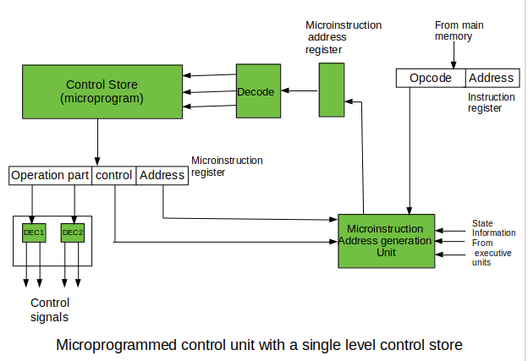

Slide 24
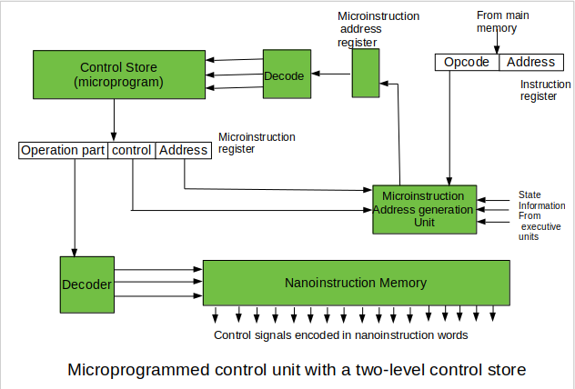

Slide 25
Control Memory: A ROM memory that is part of control unit.
Each word in control memory, called control word, stores binary control variables.
Each word in control memory contains a microinstruction
A microinstruction specifies one or more micro-operations.
A sequence of microinstructions constitutes a microprogram.
Each control word contains signals to activate one or more micro-operations
Microinstructions are retrieved in sequence and executed to activate one or more micro-operations.

Slide 26
The address of micro-instruction that is to be executed is stored in the control address register (CAR).
Micro-instruction corresponding to the address stored in CAR is fetched
from control memory and is stored in the control data register (CDR).
This micro-instruction contains control word to execute one or more
micro-operations.
After the execution of all micro-operations of micro-instruction, the
address of next micro-instruction is located.

Slide 27
Structure of a micro-instruction
Control field holds the control information (may or may not be encoded) required to issue control signals.
Condition code allows conditional branching by specifying the external conditions (status bits) that must be met.
Branch address specifies the address of the next instruction to execute if the branch condition is met
Control field | Condition code | Branch address

Slide 28
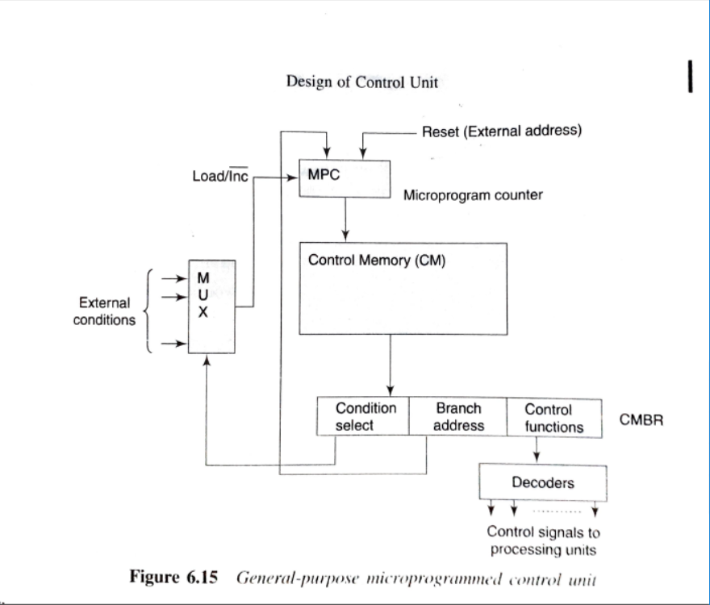
Microprogrammed Control Unit Architecture

Slide 29
Methods of Microprogramming
Microprogramming Method Classification:
Based on the organization of control information in micro-instruction:
Horizontal Microprogramming
Vertical Microprogramming
Design Goals:
Reduce Cost
Reduce size of control memory -> reducing size of microinstructions
Increase Efficiency
Degree of parallelism in micro-operation activation

Slide 30
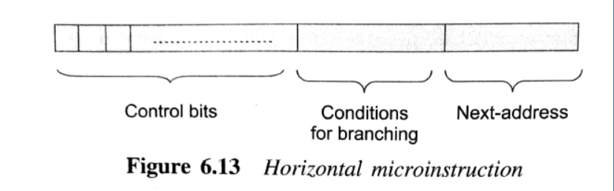
Horizontal Micro-programming
An individual bit for each control signal
The control fields are in un-encoded format.
High parallelism – several control signals can be simultaneously generated.
Large instruction size due to long format
Higher cost: Requires larger control memory
High in efficiency: Due to High degree of parallelism

Slide 31
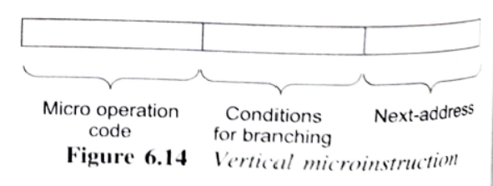
Vertical micro-programming
Control information is encoded as Micro-operation code in control field of micro-instruction
Requires a decoder for decoding control field
Takes more time in generating control signals due to decoding overhead
Low degree of parallelism – one micro-op code activates one control line
Hybrid Approach: Multiple micro-operation code, each for disjoint groups of control signals, can be specified to issue control signals in parallel
Micro-instruction size is small, micro-program size increases
Cost Efficient: Requires smaller control memory

Slide 32
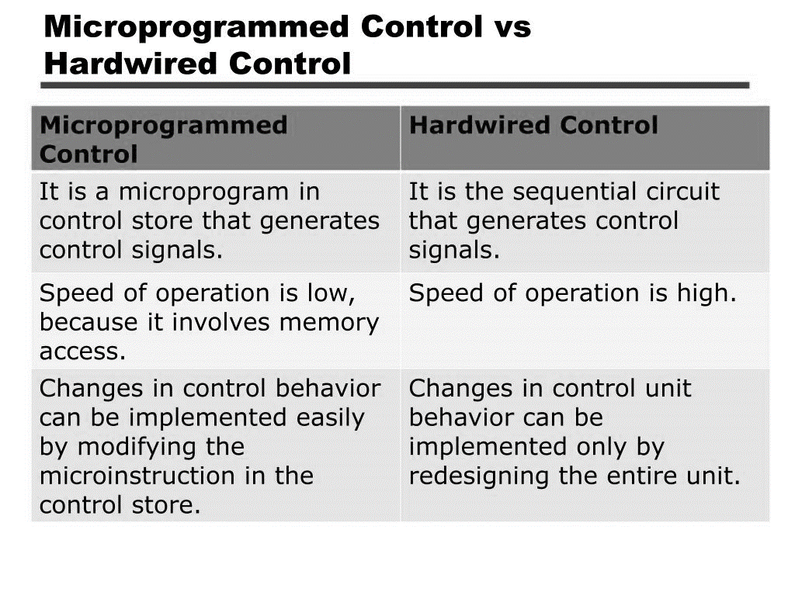

Slide 33
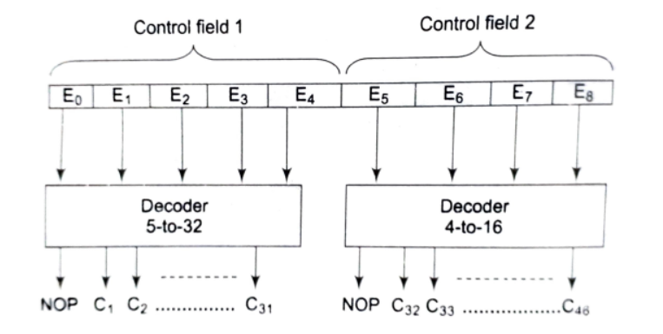
Problem on Micro-instruction
Problem 1.
An encoded microinstruction format is to be used in control unit. Show how a 9-bit micro-operation field can be divided into subfields to specify 46 different control signals.

Slide 34
Emulator program
Emulator: The set of microprograms that interpret a particular instruction set or machine language ML is called an emulator for ML.
The instruction op-code identifies the corresponding microprogram that emulates
The micro-programs can be written in symbolic form and translated by an assembler to binary.

Slide 35
CISC (Complex instruction Set Computer)
RISC (Reduced instruction Set Computer)

Slide 36
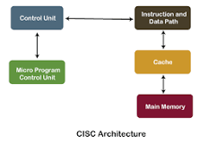
CISC, which stands for Complex Instruction Set Computer.
Each instruction executes multiple low level operations
Example: A single instruction can load from memory, perform an arithmetic operation, and store the result in memory.
Smaller program size.

Slide 37
Complex instruction, hence complex instruction decoding.
Instructions are larger than one-word size.
Instruction may take more than a single clock cycle to get executed.
Less number of general-purpose registers as operations get performed in memory itself.
Complex Addressing Modes.
More Data types.
it became apparent that a complex instruction set has a number of disadvantages:
These include a complex instruction decoding scheme, an increased size of the control unit, and increased logic delays

Slide 38
The main idea behind RISC is to make hardware simpler by using an instruction set composed of a few basic steps for loading, evaluating, and storing operations just like a load command will load data, a store command will store the data.

Slide 39
RISC, or Reduced Instruction Set Computer. is a type of microprocessor architecture that utilizes a small, highly-optimized set of instructions, rather than a more specialized set of instructions often found in other types of architectures.
History : The first RISC projects came from IBM, Stanford, and UC-Berkeley in the late 70s and early 80s. The IBM 801, Stanford MIPS, and Berkeley RISC 1 and 2 were all designed with a similar philosophy which has become known as RISC. Certain design features have been characteristic of most RISC processors:

Slide 40
Characteristic of RISC –
Simpler instruction, hence simple instruction decoding.
Instruction comes undersize of one word.
Instruction takes a single clock cycle to get executed.
More general-purpose registers.
Simple Addressing Modes.
Fewer Data types.
A pipeline can be achieved.

Slide 41
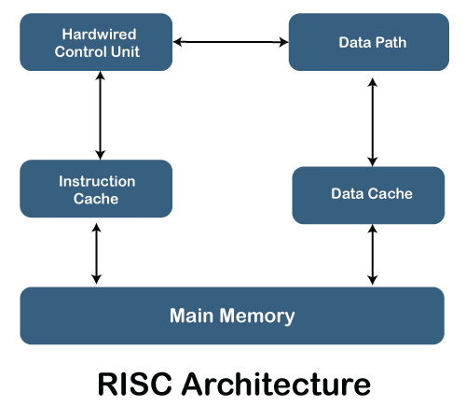
one cycle execution time: RISC processors have a CPI (clock per instruction) of one cycle. This is due to the optimization of each instruction on the CPU and a technique called pipelining.
pipelining: a technique that allows for simultaneous execution of parts, or stages, of instructions to more efficiently process instructions;
large number of registers: the RISC design philosophy generally incorporates a larger number of registers to prevent in large amounts of interactions with memory

Slide 42
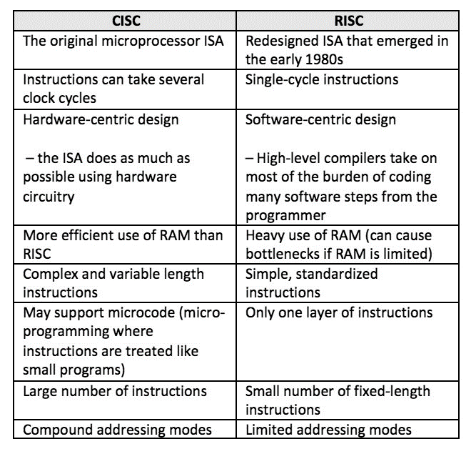

Slide 43
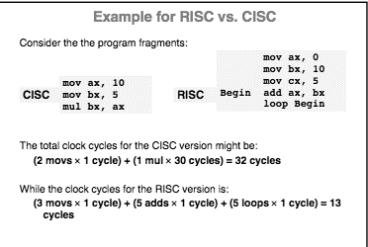

Slide 44
INPUT-OUTPUT ORGANIZATION

Slide 45
INPUT-OUTPUT ORGANIZATION
The I/O subsystem of a computer provides an efficient mode of communication between the central system and the outside environment. It handles all the input output operations of the computer system.

Slide 46
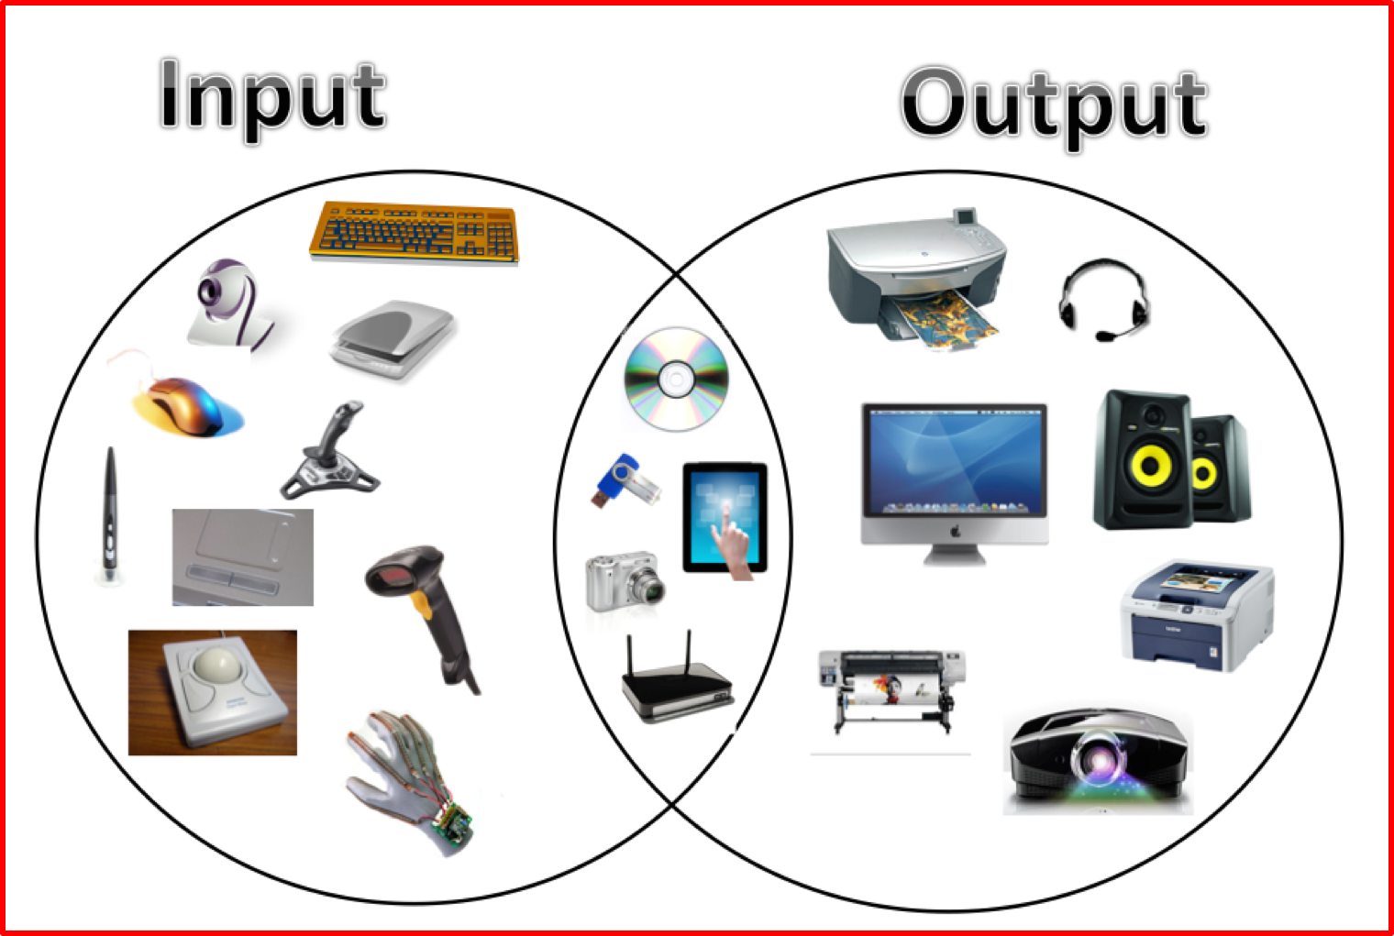

Slide 47
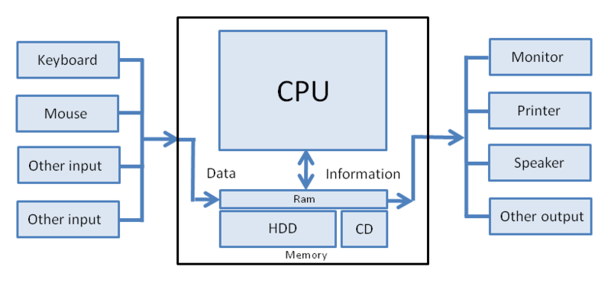
To use a peripheral device, two modulesrequired:
I/O interface or controller
I/O deriver

Slide 48
Functions of Input-Output Interface:
It is used to synchronize the operating speed of CPU with respect to input-output devices.
It selects the input-output device which is appropriate for the interpretation of the input-output device.
It is capable of providing signals like control and timing signals.
In this data buffering can be possible through data bus.
There are various error detectors.
It converts serial data into parallel data and vice-versa.
It also convert digital data into analog signal and vice-versa.

Slide 49


Slide 50
I/O Interface
A conversion of signal values may be required
» Peripherals are electromagnetic or electromechanical device where processor is a electronic device. Ie. CPU(Electronics) / HDD(Electromechanical and Electromagnet)
A synchronization mechanism may be needed
» The data transfer rate of peripherals is usually slower than the transfer rate of the CPU
Data codes and formats in peripherals differ from the word format in the CPU and Memory
The operating modes of peripherals are different from each other : 4 modes
Each peripherals must be controlled so as not to disturb the operation of other peripherals connected to the CPU
Special hardware components between the CPU and peripherals
Supervise and Synchronize all input and output transfers

Slide 51
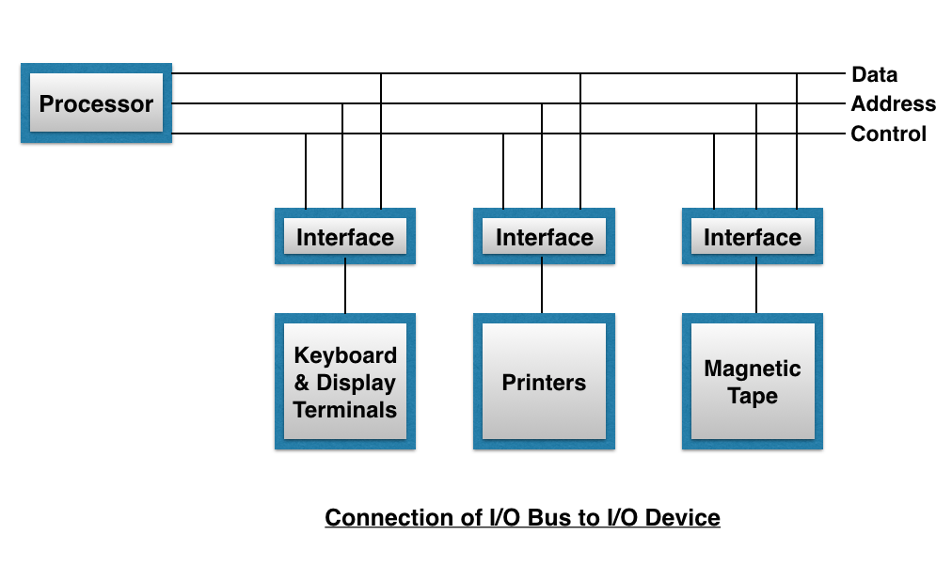
Each I/O interface unit decodes address & control. Signal received from I/O bus, interprets them for peripherals & provides signal for peripheral.
E.g. Printer controls paper monitor, printing time & selection of printing characters.

Slide 52
CONTROL – To enable devices (peripherals) e.g. Rewind magnetic tape.
TEST – Test status conditions
e.g. CPU checks whether device is turned on / in executable condition or not.
READ – this causes I/O interface to obtain a data item, from peripheral & places it in buffer (DR).
WRITE – this causes I/O interface to take data item from data bus & transfer it to peripheral.

Slide 53
SERIAL : Only one data line for data transfer and bits are transmitted serially one after other.(Example: USB)
PARALLEL : Multiple data lines in parallel for data transfer so, multiple data's can be transferred simultaneously.

Slide 54
I/O Driver
A software module that issues different commands to the I/O Controller for executing operations.
Few operations:
Reading file from disk.
Printing lines by printer.
Displaying message on monitor.
Storing data on disk.

Slide 55
The interfacing of the I/O devices can be done in two ways:
I/O Mapped I/O Interfacing (also known as isolated I/O interfacing)
Memory-Mapped I/O Interfacing

Slide 56
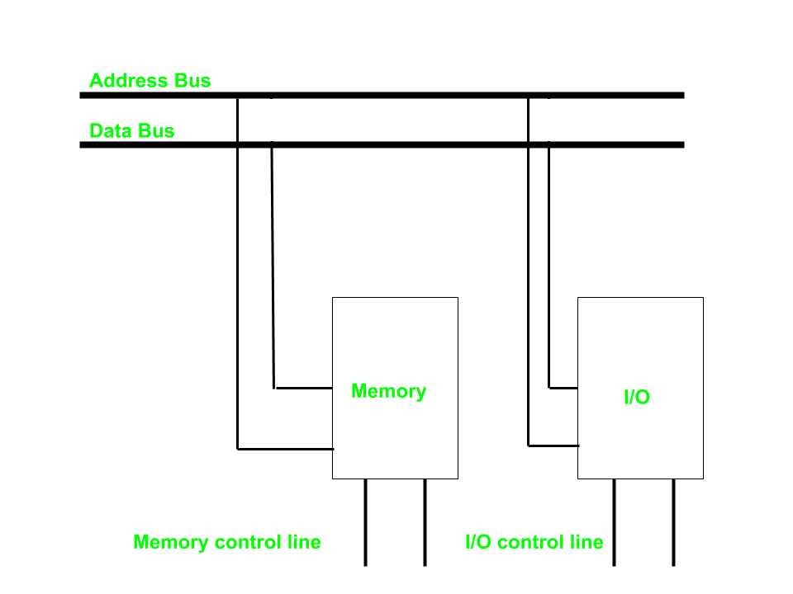
Isolated I/O –
Then we have Isolated I/O in which we Have common bus(data and address) for I/O and memory but separate read and write control lines for I/O. So when CPU decode instruction then if data is for I/O then it places the address on the address line and set I/O read or write control line on due to which data transfer occurs between CPU and I/O. As the address space of memory and I/O is isolated and the name is so. The address for I/O here is called ports. Here we have different read-write instruction for both I/O and memory.

Slide 57
As the address space of memory and I/O is isolated. The address for I/O here is called ports. Here we have different read-write instruction for both I/O and memory.
I/O read and I/O write lines for I/O transfer
Memory Write and Memory Read for memory transfer
Hence IN and OUT instruction deals with I/O transfer and MOV with memory transfer.

Slide 58
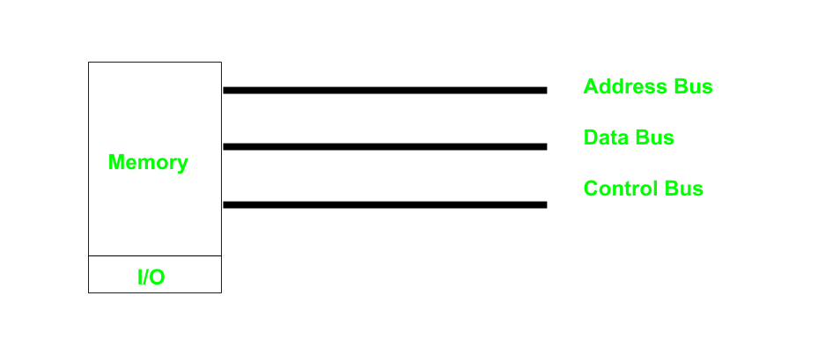
The technique in which CPU addresses an I/O device just like a memory location is called memory mapped I/O scheme.
In this scheme only one address space is used by CPU. Some addresses of the address space are assigned to memory location and other are assigned to I/O devices.

Slide 59
IO Mapped IO | Memory Mapped IO
Memory and I/O have separate address space | Both have same address space
All address can be used by the memory | Due to addition of I/O addressable memory become less for memory
Separate instruction control read and write operation in I/O and Memory | Same instructions can control both I/O and Memory
In this I/O address are called ports. | Normal memory address are for both
More efficient due to separate buses | Lesser efficient
Larger in size due to more buses | Smaller in size
It is complex due to separate separate logic is used to control both. | Simpler logic is used as I/O is also treated as memory only.

Slide 60
Data Transfer

Slide 61
When two units communicate, one becomes master, other is slave.
Two types:
Synchronous transfer
Asynchronous transfer

Slide 62
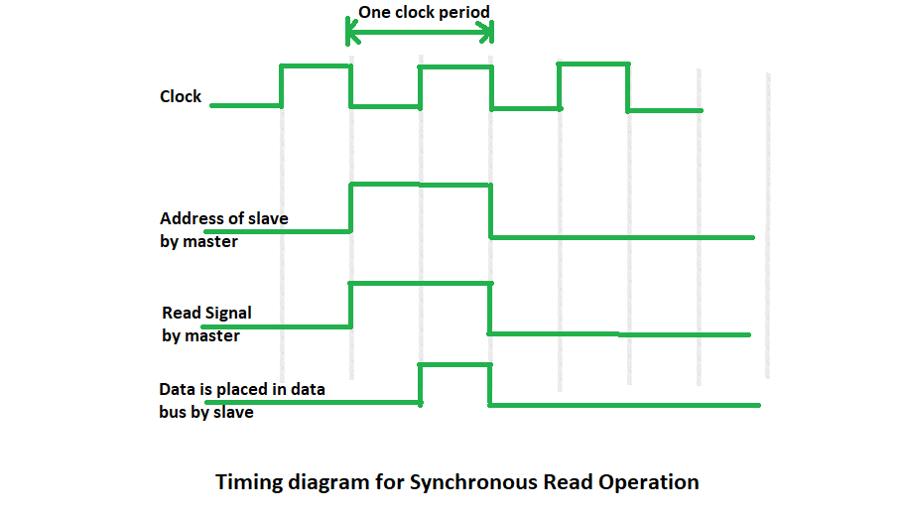
Synchronous data transfer
In Synchronous data transfer, the sending and receiving units are enabled with same clock signal. It is possible between two units when each of them knows the behavior of the other

Slide 63
Advantages –
The design procedure is easy. The master does not wait for any acknowledges signal from the slave, though the master waits for a time equal to slave’s response time.
The slave does not generate an acknowledge signal, though it obeys the timing rules as per the protocol set by the master or system designer.
Disadvantages –
If a slow speed unit connected to a common bus, it can degrade the overall rate of transfer in the system.
If the slave operates at a slow speed, the master will be idle for some time during data transfer and vice versa.

Slide 64
Asynchronous data transfer
Asynchronous data is data that is not synchronized when it is sent or received. In this type of transmission, signals are sent between the computers and external systems or vice versa in an asynchronous manner.

Slide 65
Strobe control: A strobe pulse is supplied by one unit to indicate to the other unit when the transfer has to occur.
Handshaking: This method is commonly used to accompany each data item being transferred with a control signal that indicates data in the bus. The unit receiving the data item responds with another signal to acknowledge receipt of the data.

Slide 66
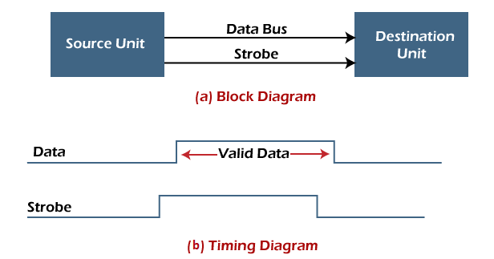
Strobe Control Method
Source initiated strobe: In the below block diagram, you can see that strobe is initiated by source, and as shown in the timing diagram, the source unit first places the data on the data bus.

Slide 67

Strobe Control Method
Destination initiated strobe: In the below block diagram, you see that the strobe initiated by destination, and in the timing diagram, the destination unit first activates the strobe pulse, informing the source to provide the data.

Slide 68
Handshaking Method
The strobe method has the disadvantage that the source unit that initiates the transfer has no way of knowing whether the destination has received the data that was placed in the bus. Similarly, a destination unit that initiates the transfer has no way of knowing whether the source unit has placed data on the bus.
In this method, one control line is in the same direction as the data flow in the bus from the source to the destination. The source unit uses it to inform the destination unit whether there are valid data in the bus.

Slide 69
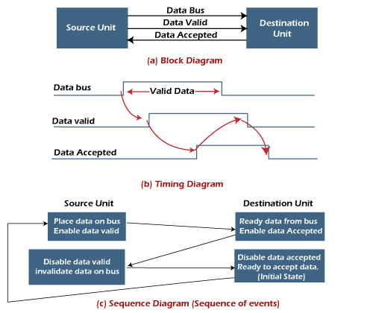

Slide 70
Source initiated handshaking: In the below block diagram, you can see that two handshaking lines are "data valid", which is generated by the source unit, and "data accepted", generated by the destination unit.

Slide 71
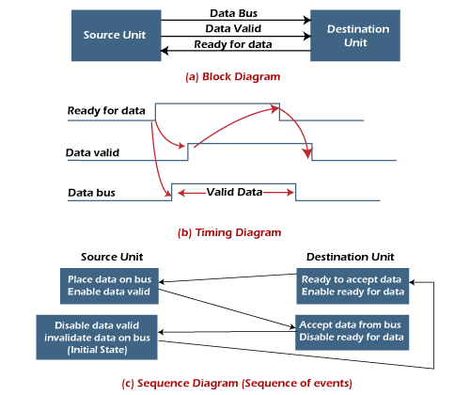
Destination initiated handshaking: In the below block diagram, you see that the two handshaking lines are "data valid", generated by the source unit, and "ready for data" generated by the destination unit.

Slide 72
Modes of Transfer

Slide 73
Programmed I/O
Interrupt initiated I/O
Direct Memory Access(DMA)

Slide 74
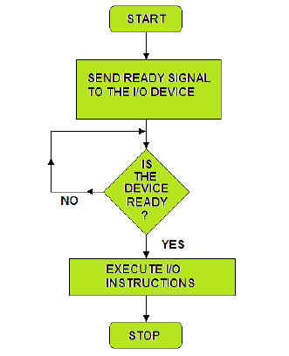
Programmed I/O
In programmed I/O, the processor keeps on scanning whether any device is ready for data transfer.
If an I/O device is ready, the processor fully dedicates itself in transferring the data between I/O and memory.
It transfers data at a high rate, but it can’t get involved in any other activity during data transfer. This is the major drawback of programmed I/O.

Slide 75
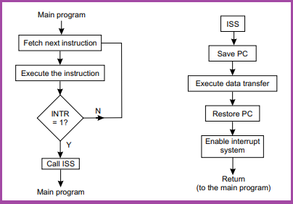
Interrupt initiated I/O
In Interrupt driven I/O, whenever the device is ready for data transfer, then it raises an interrupt to processor.
Processor completes executing its ongoing instruction and saves its current state. It then switches to data transfer which causes a delay.
Here, the processor doesn’t keep scanning for peripherals ready for data transfer.
But, it is fully involved in the data transfer process. So, it is also not an effective way of data transfer.

Slide 76
Direct Memory Access(DMA)
The DMA controller completes the task of transferring large block of data at a faster rate and is also effective.
The DMA controller transfers the data in three modes:
Burst Mode: Here, once the DMA controller gains the charge of the system bus, then it releases the system bus only after completion of data transfer. Till then the CPU has to wait for the system buses.
Cycle Stealing Mode: In this mode, the DMA controller forces the CPU to stop its operation and relinquish the control over the bus for a short term to DMA controller. After the transfer of every byte, the DMA controller releases the bus and then again requests for the system bus. In this way, the DMA controller steals the clock cycle for transferring every byte.
Transparent Mode: Here, the DMA controller takes the charge of system bus only if the processor does not require the system bus.

Slide 77
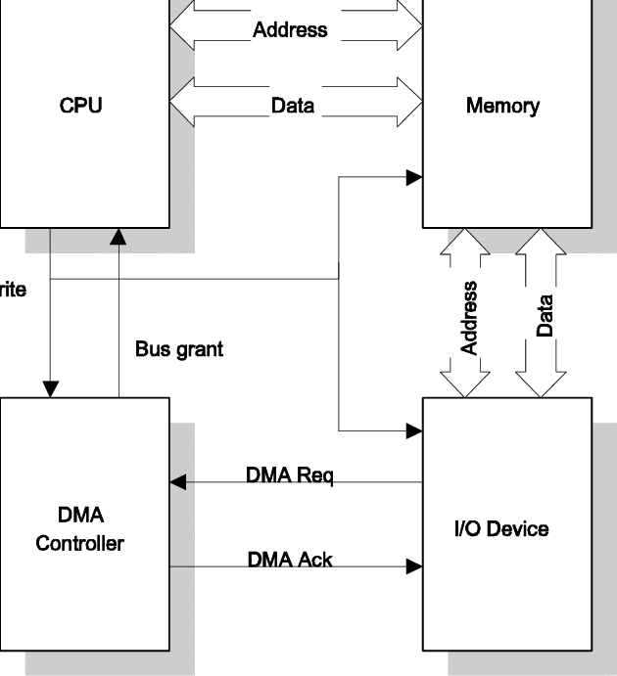
Whenever an I/O device wants to transfer the data to or from memory, it sends the DMA request (DRQ) to the DMA controller. DMA controller accepts this DRQ and asks the CPU to hold for a few clock cycles by sending it the Hold request (HLD).
CPU receives the Hold request (HLD) from DMA controller and relinquishes the bus and sends the Hold acknowledgement (HLDA) to DMA controller.
After receiving the Hold acknowledgement (HLDA), DMA controller acknowledges I/O device (DACK) that the data transfer can be performed and DMA controller takes the charge of the system bus and transfers the data to or from memory.

Slide 78
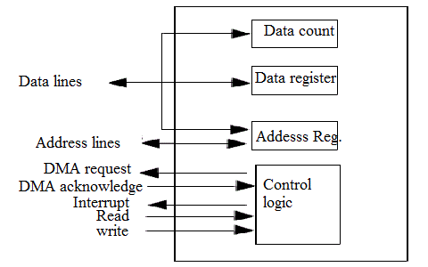

Slide 79
Draw and explain the architecture of a hardwired control unit.
Draw and explain the architecture of a micro programmed control unit.
State peripherals. Explain the jobs of a I/O interface. Compare isolated I/O and memory mapped I/O. Describe the term ‘strobe’, ‘handshaking’ in asynchronous data transfer.
Describe the different modes of data transfer. In a memory system: cache access time is of 50 nsec, main memory access time is of 500nsec, hit ratio of 0.9. Calculate average access time.
Rewrite why RISC architecture has lesser CPI than CISC. Explain how RISC architecture does overcome Von Neumann Bottleneck. Analyze why CISC architecture is complex than RISC.
Explain how CISC computer uses more instructions in their instruction set. State how CISC architecture does overcome Von Neumann Bottleneck.
Differentiate between polled IO, Interrupt initiated IO and DMA. Classify the advantages of IO controller.
Summerize the tasks of DMA controller. Point out the tasks of IO interfaces. Differentiate between peripherals and main computer system.

Slide 80
Thank You

